Slide 1
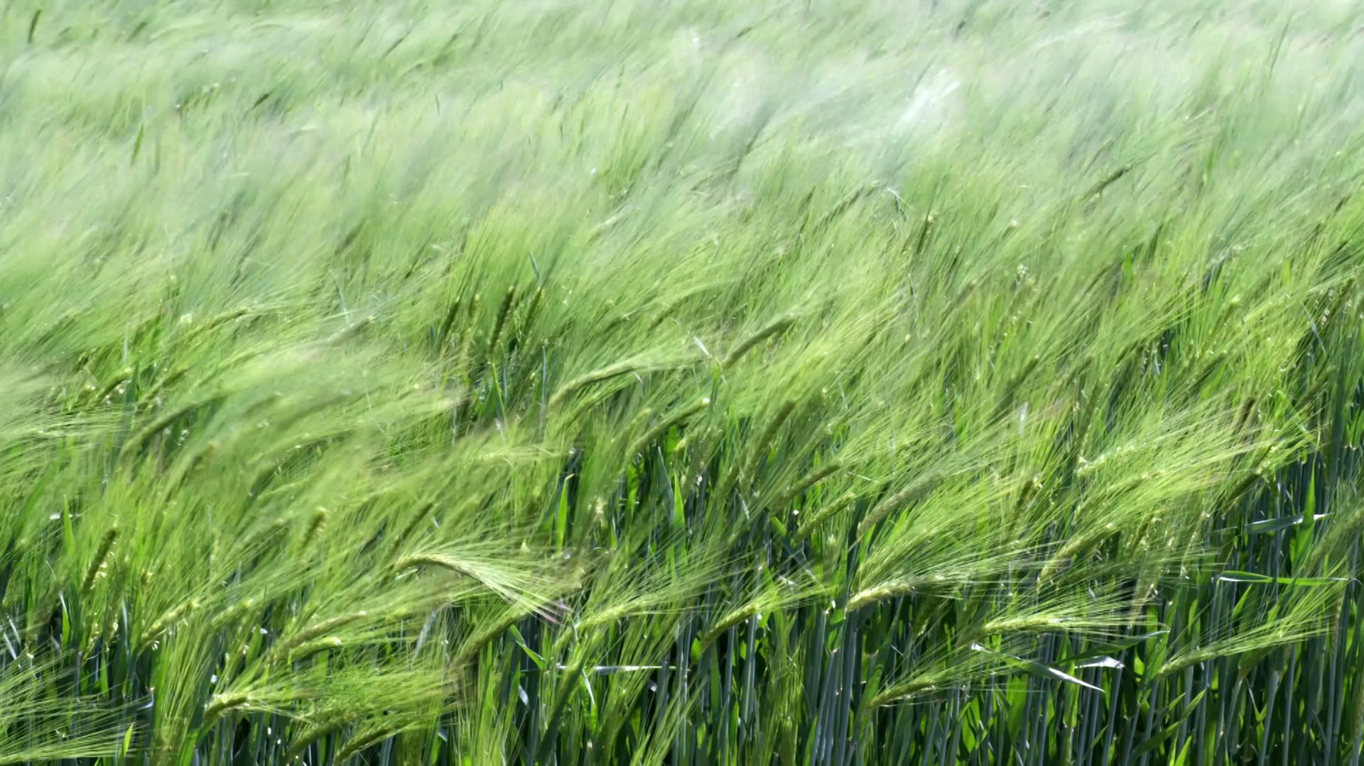
CropSight AI Plant Disease Prediction Tool
Group 16
Gagan Tuli (101494300)
Smit Kumar Mewada (101480503)
Surajsinh Ramlavat (101474962)
Vinayak Goyal (101446976)

Slide 2
Agenda
Problem
Significance
Methodology – ML Canvas
Model Benchmarking
Model Deployment
Demo
Q&A

Slide 3
Problem Statement
Gardening enthusiasts and plant lovers often struggle to identify plant diseases accurately, leading to frustration and potential plant loss. Similarly, when buying plants, it can be challenging to ensure they are healthy and disease-free.
Why This Problem Matters (Individual Customers):
Plant Health and Enjoyment: Early disease detection allows for prompt action, saving beloved plants and ensuring a thriving garden.
Informed Purchasing Decisions: Provides confidence when buying plants, avoiding diseased ones that could spread to other plants.

Slide 4
Problem Statement Contd
Plant retailers and nurseries face challenges in maintaining plant health and minimizing losses due to disease outbreaks. Manual inspection is often inadequate, leading to diseased plants reaching customers and damaging brand reputation.
Why This Problem Matters (Businesses):
Economic Losses: Disease outbreaks can result in significant financial losses due to plant disposal, reduced sales, and customer dissatisfaction.
Brand Reputation: Selling diseased plants can damage a company's reputation and customer trust.

Slide 5
Solution
Proposed Solution (Combined):
Our AI-powered plant disease detection system caters to both individual customers and businesses:
Web App for Individuals: Allow users to take photos of their plants and receive instant disease diagnosis.
Integration with Business Platforms: Provide businesses with tools to monitor plant health throughout the supply chain, from propagation to point-of-sale.
Benefits (Combined):
Empowering Individuals: Equipping plant lovers with the knowledge and tools to care for their plants effectively.
Supporting Businesses: Helping companies reduce losses, improve customer satisfaction, and maintain a reputation for healthy plants.
Promoting Sustainable Practices: Minimizing the need for pesticides and promoting environmentally conscious plant care.

Slide 6
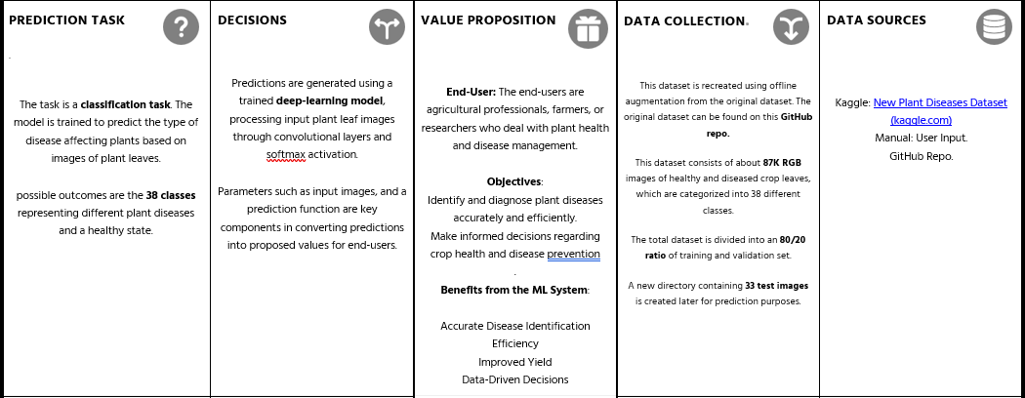
ML Canvas

Slide 7
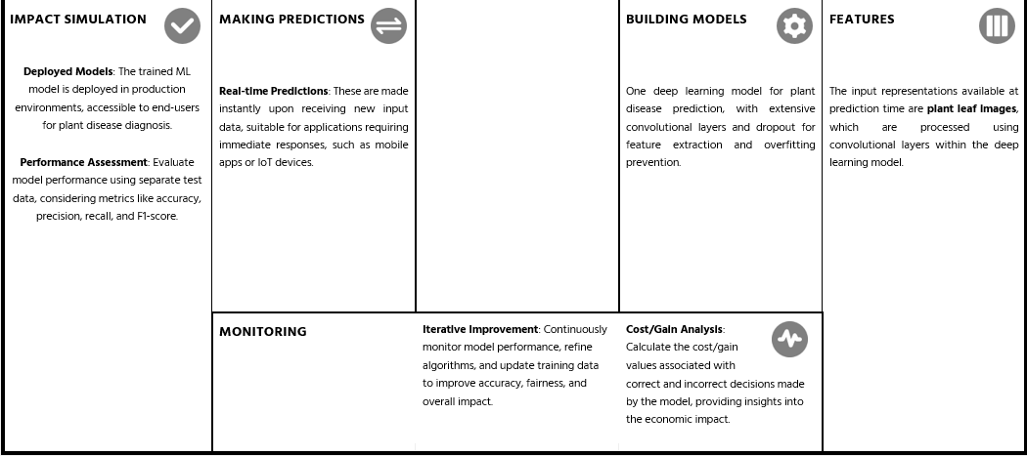
ML Canvas

Slide 8
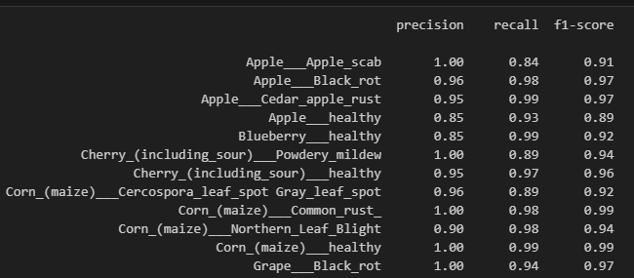
Model Benchmarking
Model:
CNN trained with 38 classes, utilizing increasing filters, dropout layers, and dense layers, along with Adam optimizer (lr=0.0001).
Evaluation metrics:
Accuracy: Training accuracy of around 95.82% and validation accuracy of around 92.59%.
Precision, Recall, and F1-score: These metrics are computed for each class in our classification problem, providing insights into how well the model performs for each type of plant disease.

Slide 9
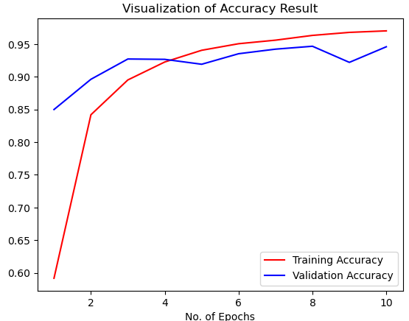
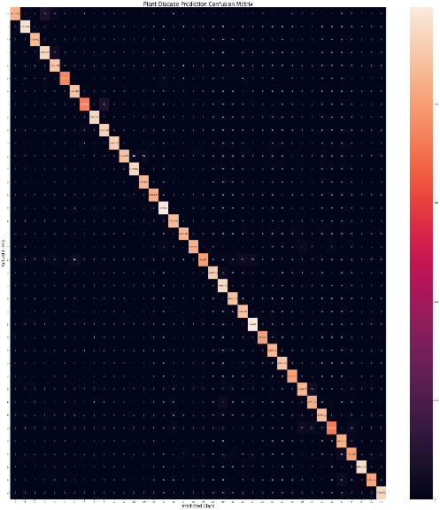
Model Benchmarking
Accuracy and Confusion matrix analysis

Slide 10
Deploying Plant Disease Prediction Model
Utilizing Streamlit Framework: Streamlit framework (v1.30.0) was used for rapid development and deployment.
Ensured compatibility with required versions: NumPy (v1.26.3)TensorFlow (v2.15.0.post1)
Seamless Integration: Seamlessly integrated the trained model into the Streamlit application for real-time predictions.
Local Testing and Validation: Conducted thorough local testing to validate functionality and responsiveness.
Deployment on Streamlit Sharing: Packaged the application along with dependencies and deployed it on Streamlit Sharing platform.

Slide 11
Challenges & Issues encountered
Data Imbalance:
Dealing with imbalanced classes in the dataset, where some classes have significantly more or fewer samples than others, can lead to biased model predictions and affect overall performance metrics.
Overfitting:
Striking a balance between model complexity and generalization is crucial.
We’ve chosen a small learning rate (0.0001) to avoid overshooting.
Hyperparameter Tuning:
Experimenting with hyperparameters such as learning rates, batch sizes, number of epochs, and dropout rates is time-consuming and requires computational resources.

Slide 12
Competitors
Plant Net
Plan tix
Blossom
Flora
Key Features of Our Product:
Instant Disease Diagnosis: Swiftly identify plant diseases with high accuracy.
Intuitive User Interface: Seamlessly navigate through our user-friendly interface, designed for accessibility and ease of use.
Integration with Business Platforms: Effortlessly integrate our solution with existing business platforms, ensuring seamless data flow and compatibility.
Comprehensive Plant Health Monitoring: Monitor the health of your plants comprehensively, enabling proactive management and optimization of crop yield

Slide 13
Financial Plan
Our Product: For just $15 per month, gain access to cutting-edge technology that revolutionizes plant health management. Unlock the power of instant disease diagnosis and comprehensive monitoring at an affordable price point.
Affiliate Marketing: Partner with agricultural influencers, bloggers, or industry experts to promote their product to their audience in exchange for a commission on sales generated through their referral links.

Slide 14
Detailed Cost Analysis
Monthly subscribers: 100
Churn rate: 5% (5 subscribers cancel each month)
Monthly revenue per subscriber: $15
Affiliate commission rate: 10%
Monthly operational costs: $600
Monthly marketing and sales costs: $200
Monthly Revenue: 100 subscribers * $15 = $1500
Monthly Affiliate Marketing Revenue: Assuming each subscriber generates one referral per year: 100 subscribers * 12 months * $15 * 10% = $1800
Total Monthly Revenue: $1500 (subscription revenue) + $1800 (affiliate revenue) = $3300
Total Monthly Costs: $600 (operational costs) + $200 (marketing and sales costs) = $800
Monthly Profit: $3300 (total revenue) - $800 (total costs) = $2500
Projected Annual Profit: $2500 * 12 months = $30,000

Slide 15


Demo
Streamlit (gagan3512-plant-disease-prediction-main-xod86j.streamlit.app)

Slide 16
Thank You.

